Slide 1
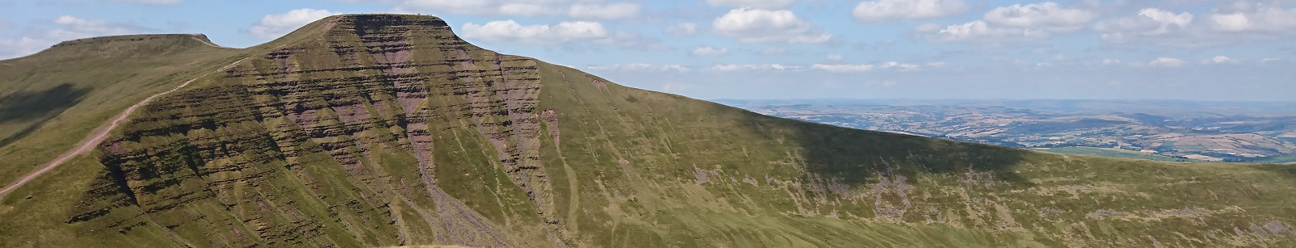
10 Peaks Brecon Beacons
√ 58 kilometres
√ 24 hours
√ 3000m of ascent
√ …and 10 peaks (obviously)
√ (very) random tech

Slide 2
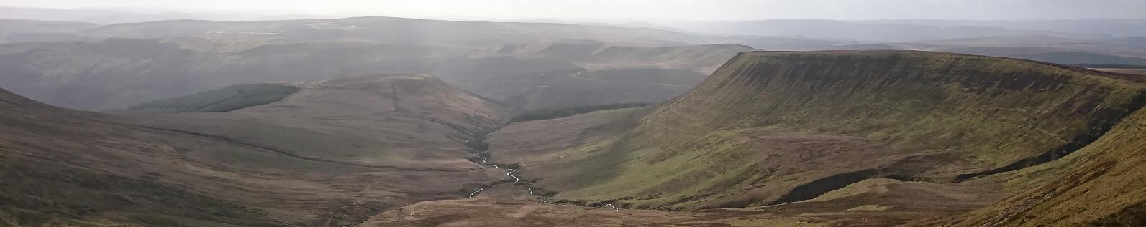
Priority
√ B.A.R.F. ™ = Begin > Attempt > Regret > (But hopefully) finish
1.0
Priority
√ Convince family to track progress and race conditions
√ Collect bucket loads of data that we’ll probably never ever need
√ Prove that true geekery can coexist with nature, outdoors
√ Raise a few quid for charity
2.0

Slide 3

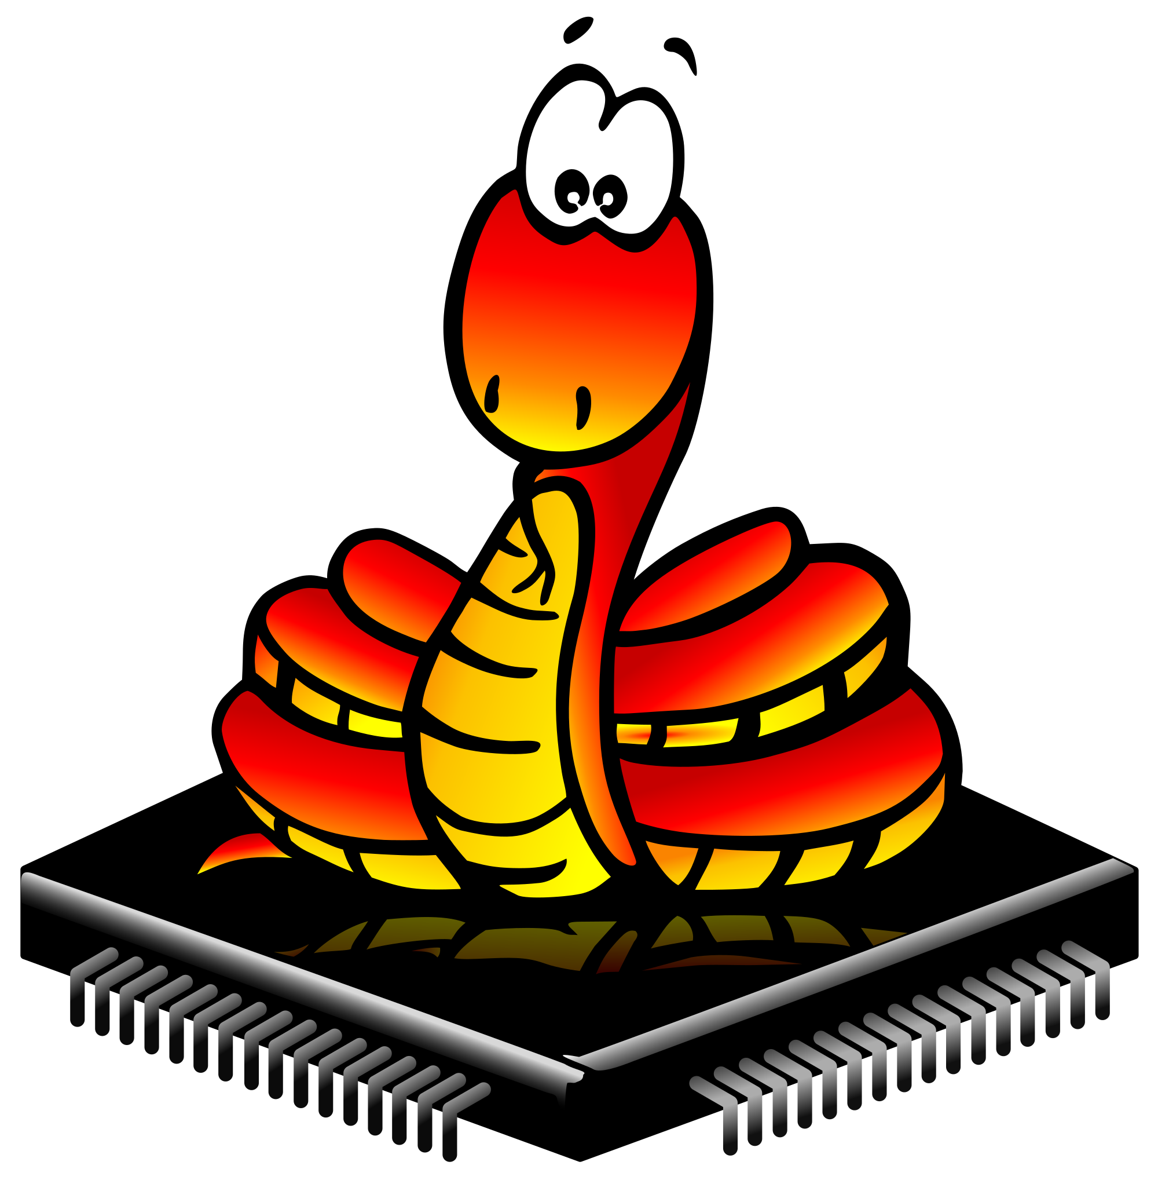



This DIY tech explained in 4 dotted lines
Tracker(s)
Brick
2.4GHz radio
ESP32
Raspberry Pi Zero
863MHz LoRa
AWS IoT HTTPS / MQTT
TTN -> AWS IoT

Slide 4
Brick
Lots of sensors of questionable value
SQLite3
Buffer DB
Tracker(s)
Records current GPS location and sensor readings
Caches and uploads its own readings, and those from trackers
Records current GPS location
Broadcasts to brick and nearest TTN gateway
Weather
BME280
MicroPython
Raspbian OS
2.4GHz radio
<100m
ESP32
Raspberry Pi Zero
3G/4G/0G
(only when we manage to climb a peak)
U-blox Neo-6
Semtech SX1276
nRF24L01+
nRF24L01+
U-blox Neo-6
AWS
863MHz LoRa
1km+
IoT Core
Elasticsearch Service
Unsuspecting
family
members
IoT Events
Graphs
LoRaWAN Gateway
Web frontend
The Things Network (TTN)
SES
Lambda
Browsing
Notifications
DynamoDB
S3
Cognito

Slide 5
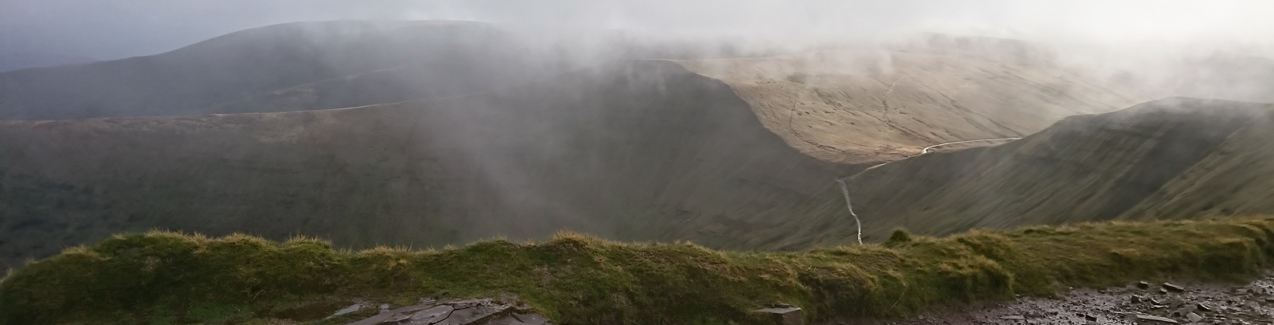
What on earth is going on in…
IoT Core
IoT Events
Device (thing) management
Message ingestion and processing
Shadow document
Device state monitoring (responding / not responding / lost)
DynamoDB
SES
Elasticsearch Service
Custom data storage (locations)
Spamming family members with updates
General dumping ground of data (Elasticsearch)
Data visualisation (Kibana)
Web frontend
S3
Lambda
Identity and Access Management
Static website hosting
General event processing (shadow document updates, notification emails, etc)
Role, policy and permissions management
Cognito
Web frontend user identity store

Slide 6
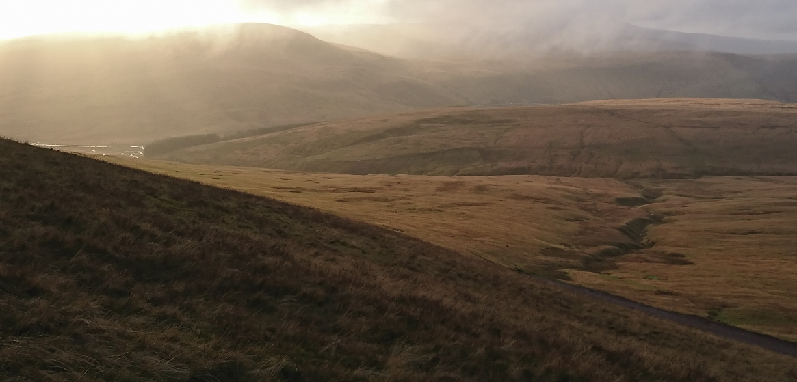
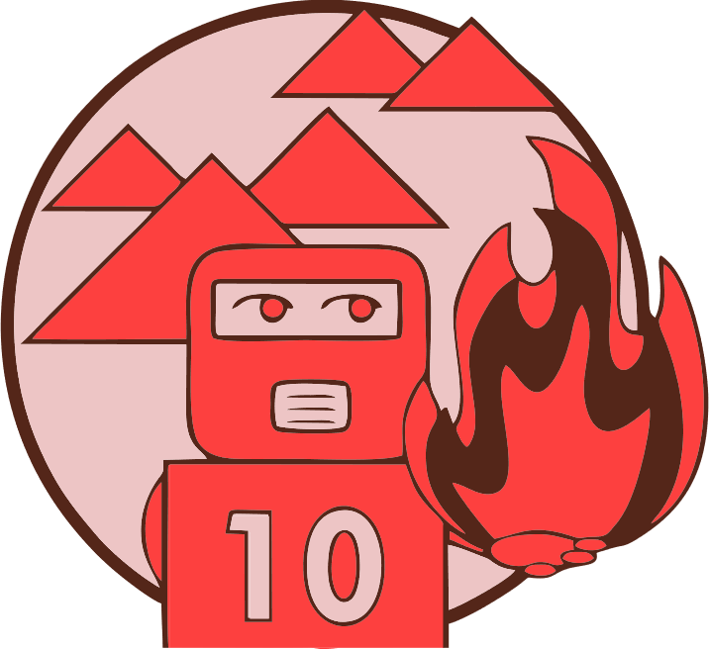
Check out the project in our GitHub repository:-
https://github.com/fantasticdonkey/rIoT
Follow us on Twitter for updates:-
@rosie_red_robot
Thanks!

